Slide 1
MACAU 2018
TIME SERIES DECOMPOSITION
AUTO ARIMA IMPLEMENTATION

Slide 2
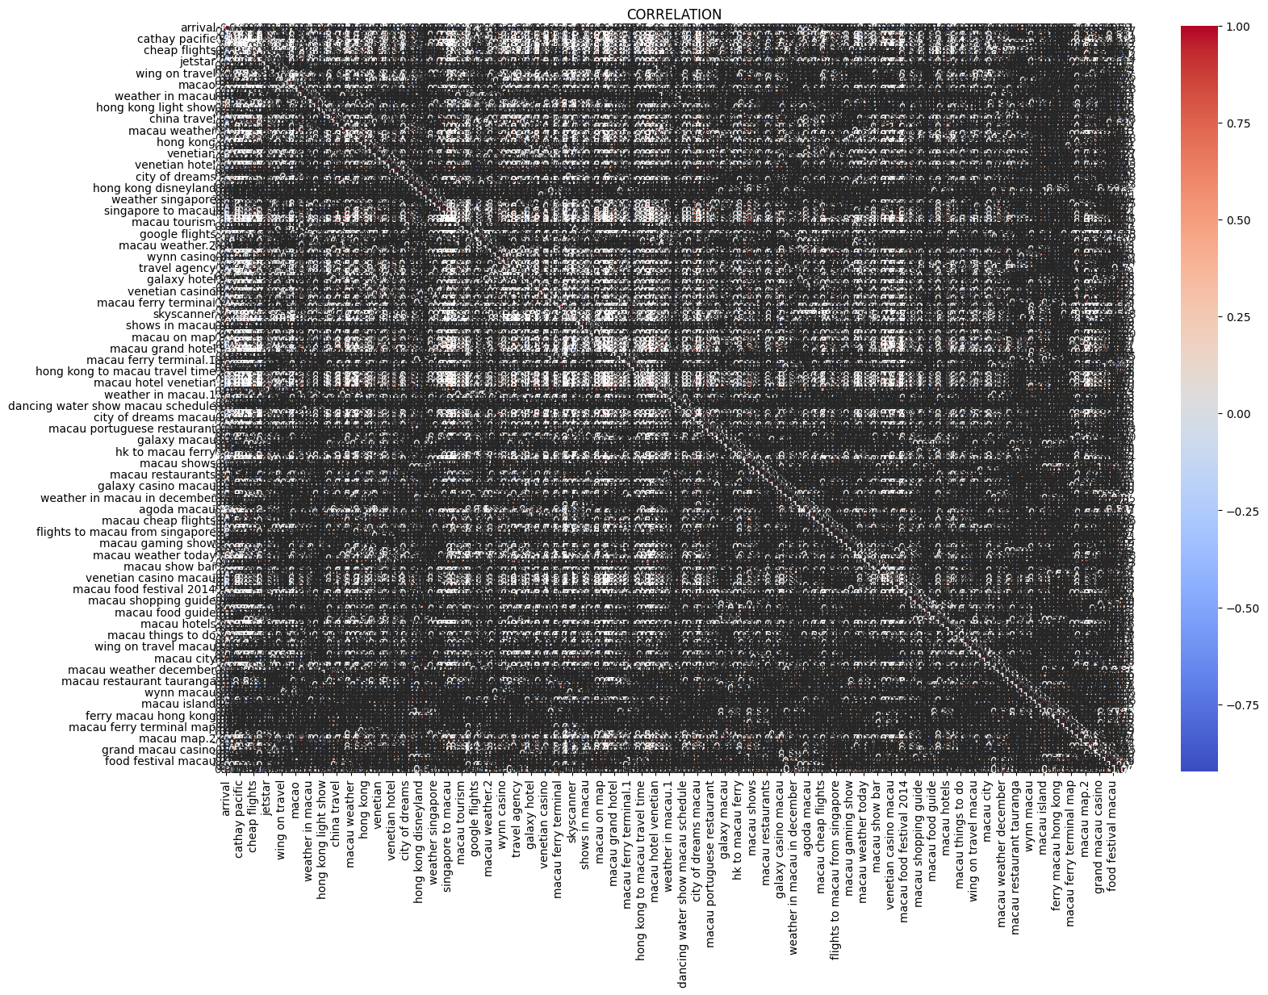
Coorelation Matrix

Slide 3
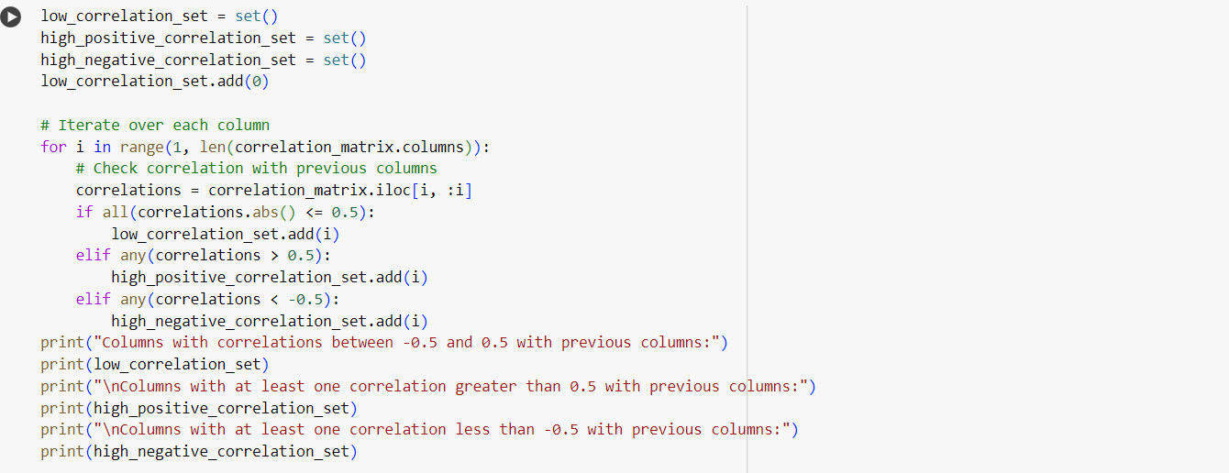

Slide 4
Columns with correlations between -0.5 and 0.5 with previous columns: {0, 1, 130, 134, 135, 10, 11, 141, 15, 19, 149, 22, 23, 150, 153, 154, 157, 158, 31, 162, 35, 163, 37, 38, 166, 42, 44, 45, 175, 178, 181, 187, 61, 74, 78, 79, 81, 89, 90, 98, 99, 105, 106, 110, 111, 114, 116, 118, 121, 124}
Columns with at least one correlation greater than 0.5 with previous columns: {3, 4, 5, 6, 7, 8, 9, 12, 13, 14, 16, 17, 20, 21, 24, 25, 26, 27, 28, 29, 30, 32, 33, 34, 36, 39, 40, 41, 43, 46, 47, 48, 49, 50, 51, 52, 53, 54, 55, 56, 57, 58, 59, 60, 62, 63, 64, 65, 66, 67, 68, 69, 70, 71, 72, 73, 75, 76, 77, 80, 82, 83, 84, 85, 86, 87, 88, 91, 92, 93, 94, 95, 96, 97, 100, 101, 102, 103, 104, 107, 108, 109, 112, 113, 115, 117, 119, 120, 122, 123, 125, 126, 127, 128, 129, 131, 132, 133, 136, 137, 138, 139, 140, 142, 143, 144, 145, 146, 147, 148, 151, 152, 155, 156, 159, 160, 161, 164, 165, 167, 168, 169, 170, 171, 172, 173, 174, 176, 177, 179, 180, 182, 183, 184, 185, 186, 188, 189, 190, 191, 192, 193, 194}
Columns with at least one correlation less than -0.5 with previous columns: {2, 18}

Slide 5
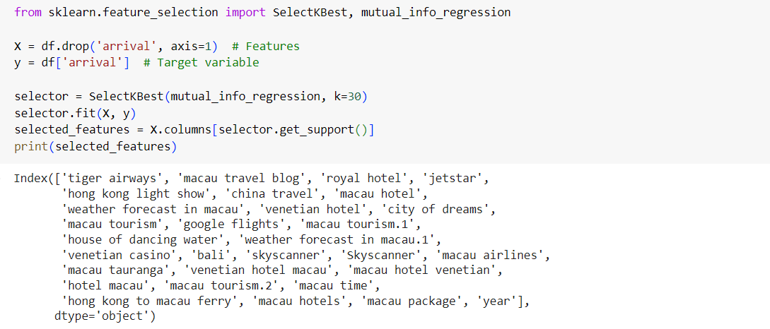
Top 30 features mutual_info_regression

Slide 6
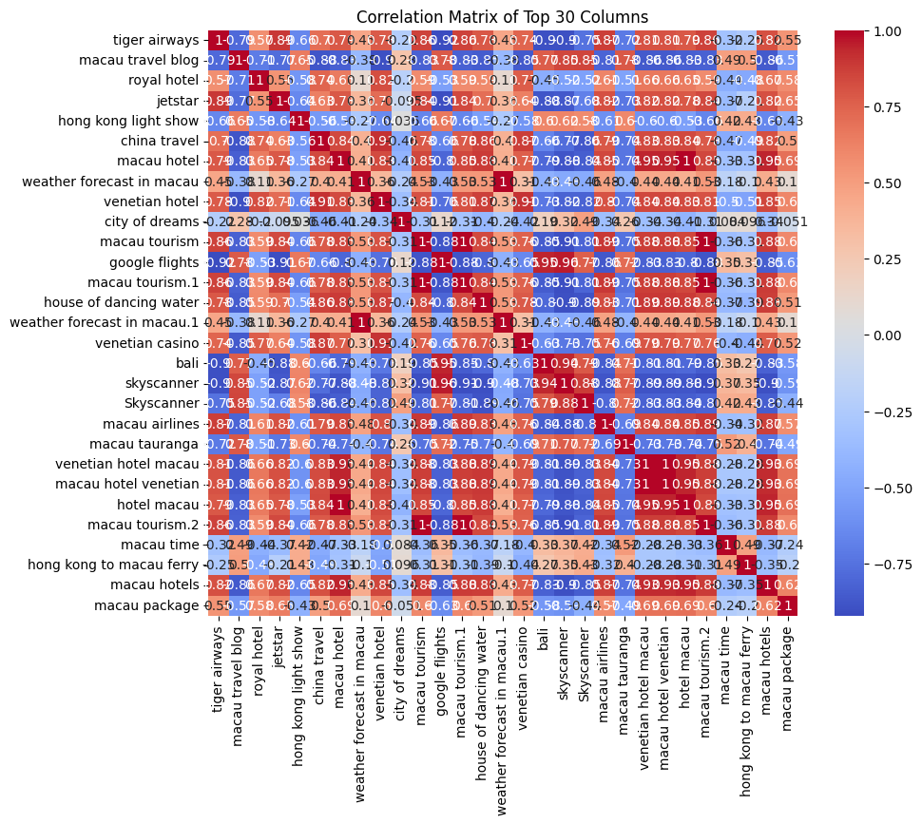
HeatMap of Top 30

Slide 7

Fischer Classification

Slide 8
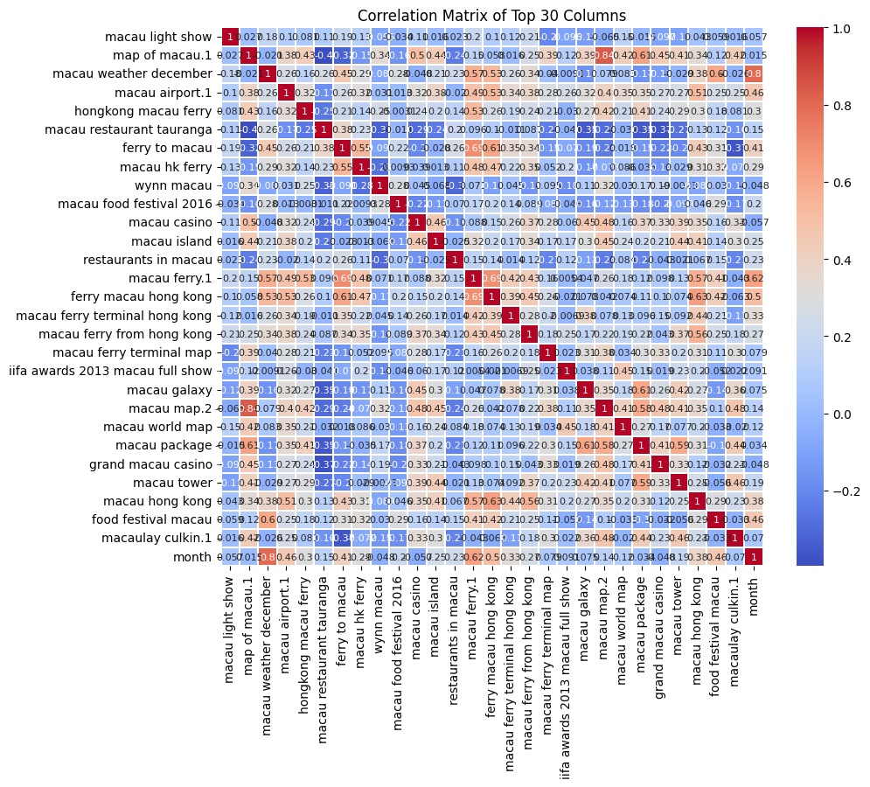

Slide 9
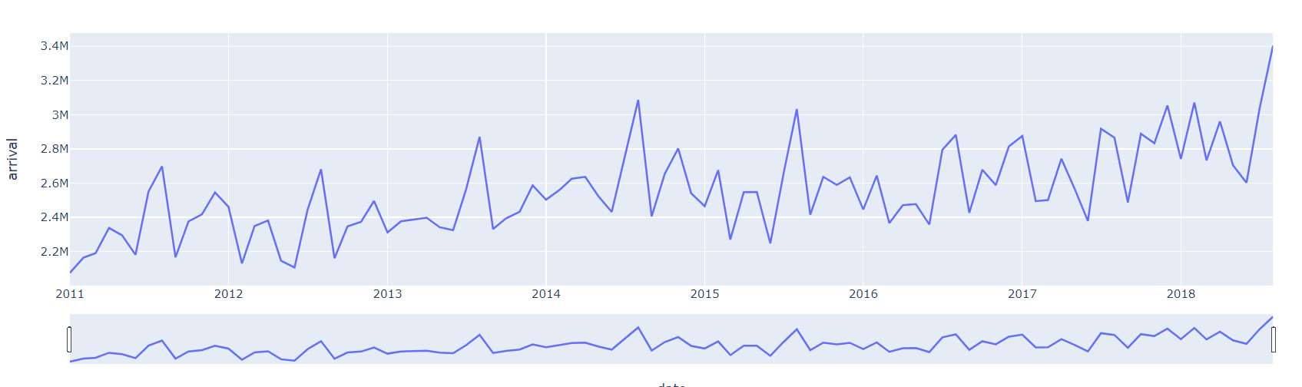
Time Series

Slide 10
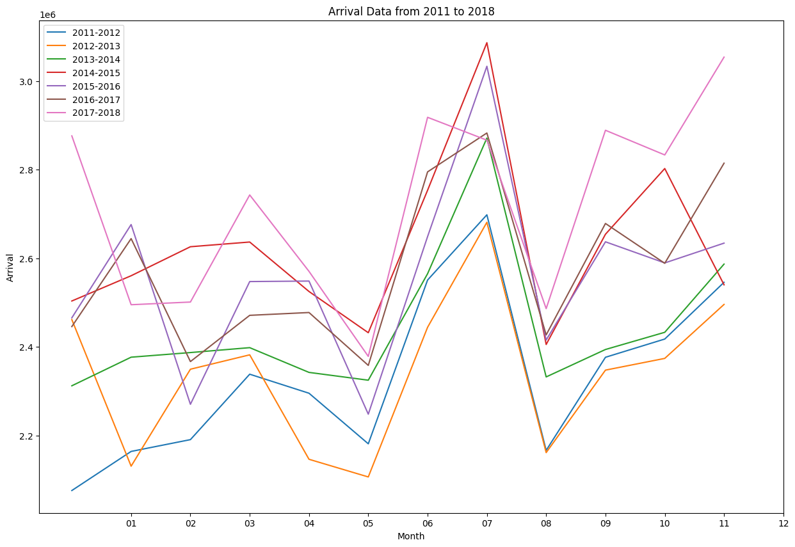
MonthWise Distribution

Slide 11
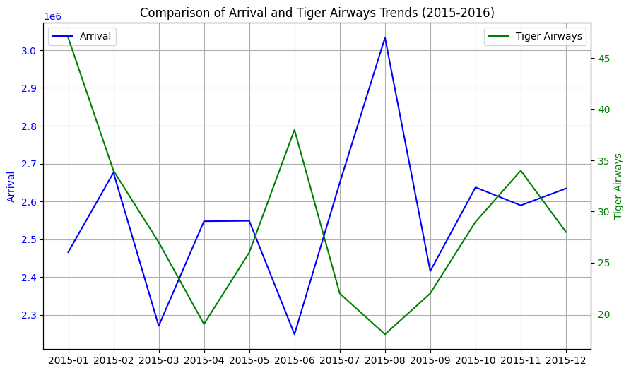
Plot with one of the most corelated feature “Tiger Airways”
The Plot suggests that the arrivals peak just after tiger airways attribute has already peaked

Slide 12
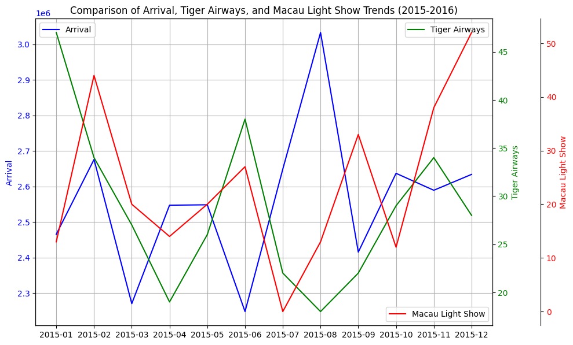
Relation between Macau light show Tiger Airways and Arrivals
Arrivals lag macau light show and tiger airways

Slide 13
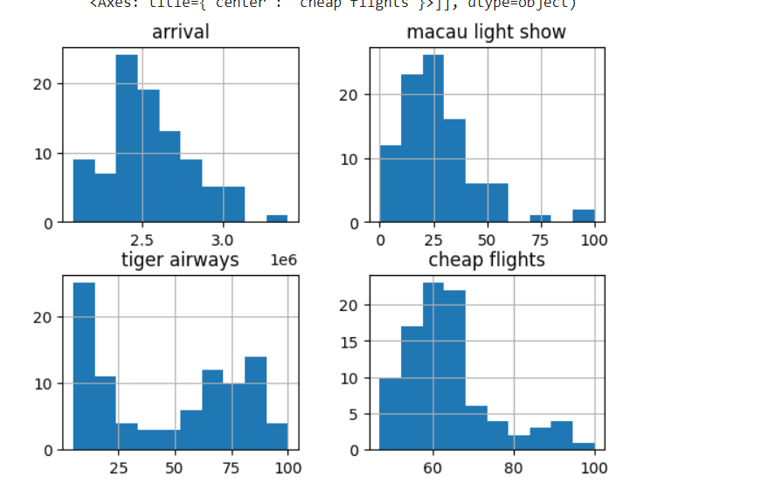
When arrivals are maximum
Tiger airways is minimum

Slide 14
- The arrival data appears to be right-skewed, indicating that there were more months with lower arrival numbers and fewer months with higher arrival numbers.
- The "macau light show" data also exhibits a right-skewed distribution, suggesting a similar pattern.
- The "tiger airways" data shows a more balanced distribution, with a peak around the middle values.
- The "cheap flights" data is also right-skewed, but with a more pronounced peak around the lower values.
Based on these observations, we can infer that:
- There is a positive relationship between arrivals and the "macau light show", as both distributions show a similar right-skewed pattern.
- The relationship between arrivals and "tiger airways" is less clear, as the distribution of "tiger airways" is more balanced.
- The relationship between arrivals and "cheap flights" is also unclear, as the distribution of "cheap flights" is right-skewed but with a more pronounced peak around the lower values.

Slide 15
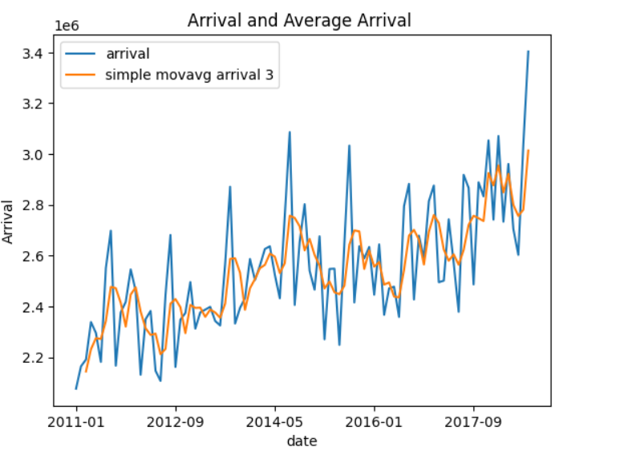
Moving Average Plots

Slide 16
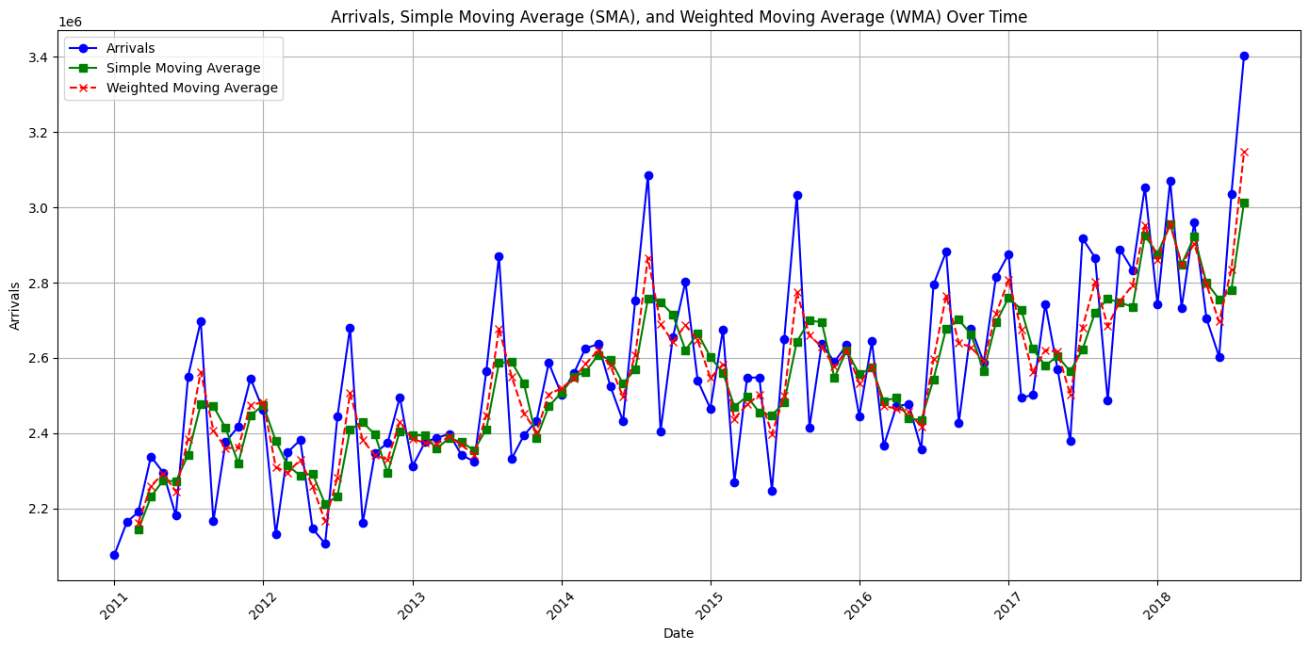

Slide 17
SMA WMA [0.5 1 1.5 ] calculated and plotted
EMA plotted with smoothening factor = 0.3 and 0.7

Slide 18
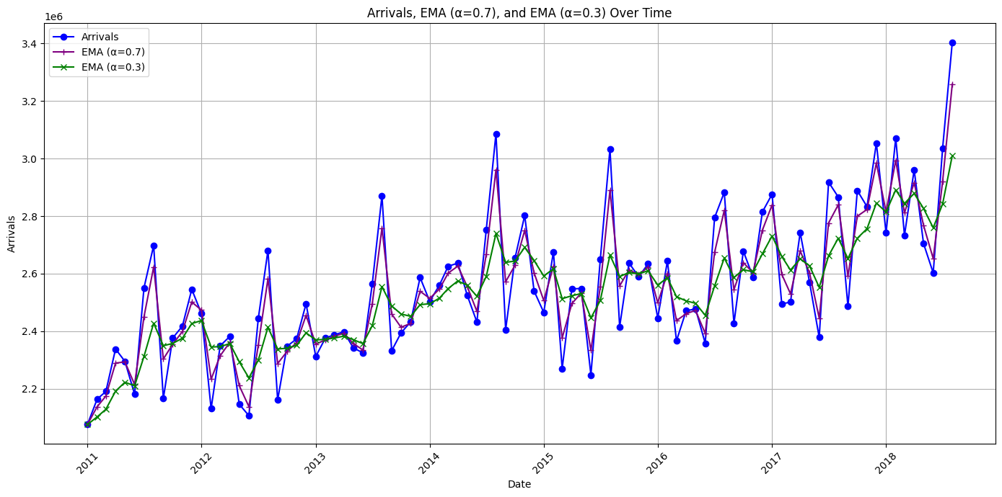

Slide 19
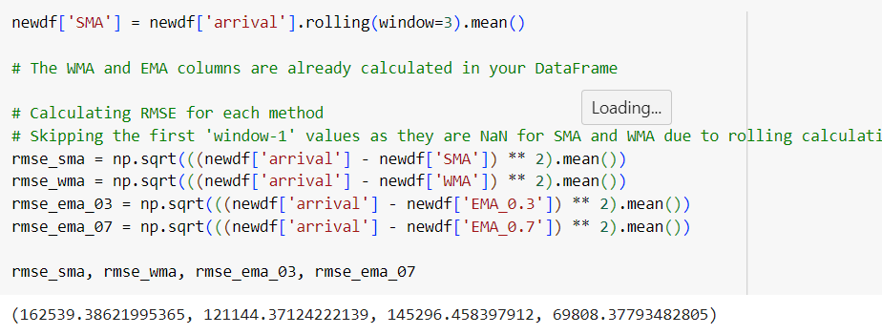
RMSE Values Calculated

Slide 20
The calculated RMSE values allow us to compare the accuracy of different smoothing methods in forecasting future arrivals:
- **Simple Moving Average (SMA)**: With an RMSE of {rmse_sma:.4f}, the SMA method shows moderate accuracy in predicting future arrivals.
- **Weighted Moving Average (WMA)**: The WMA method achieves a slightly lower RMSE of {rmse_wma:.4f}, indicating better accuracy compared to the SMA.
- **Exponential Moving Average (EMA)**: Both EMA variations, with alpha values of 0.3 and 0.7, exhibit lower RMSE values than the SMA and WMA.
- EMA (α=0.7): RMSE of {rmse_ema_07:.4f} suggests better responsiveness to recent data changes.
- EMA (α=0.3): RMSE of {rmse_ema_03:.4f} provides a smoother trend while still capturing important fluctuations.
Based on these RMSE values, we can infer that the EMA methods, particularly with alpha values of 0.3 and 0.7, offer the most accurate forecasts for future arrivals compared to the SMA and WMA methods. This is because the EMA method places more weight on recent data points, allowing it to adapt more quickly to changing trends and patterns in the arrival data.

Slide 21
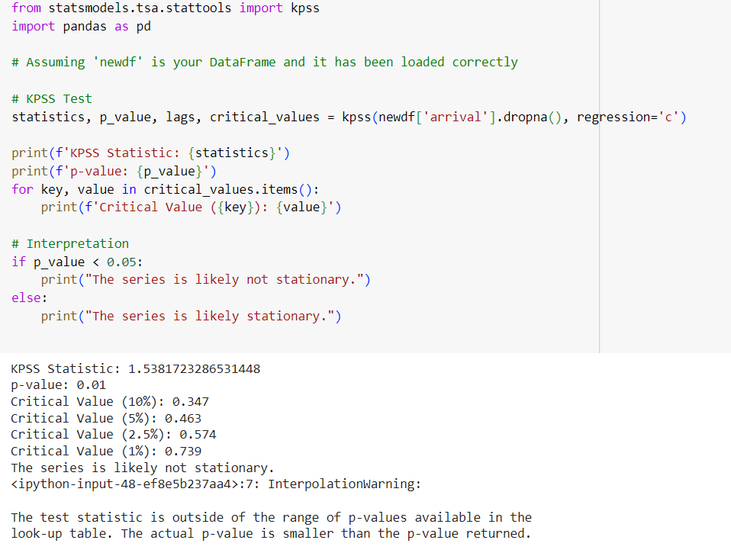
Stationarity Tests about a constant value

Slide 22
KPSS Statistic: The test statistic value is 1.538, which is greater than the critical values at all significance levels (10%, 5%, 2.5%, and 1%).
p-value: The p-value of 0.01 is less than 0.05, indicating that you can reject the null hypothesis of stationarity at the 5% significance level.
In the context of the KPSS test, the null hypothesis assumes that the series is stationary around a deterministic trend. A low p-value (less than the typical alpha level of 0.05) suggests that the null hypothesis can be rejected, implying the series has a unit root and is not stationary.

Slide 23
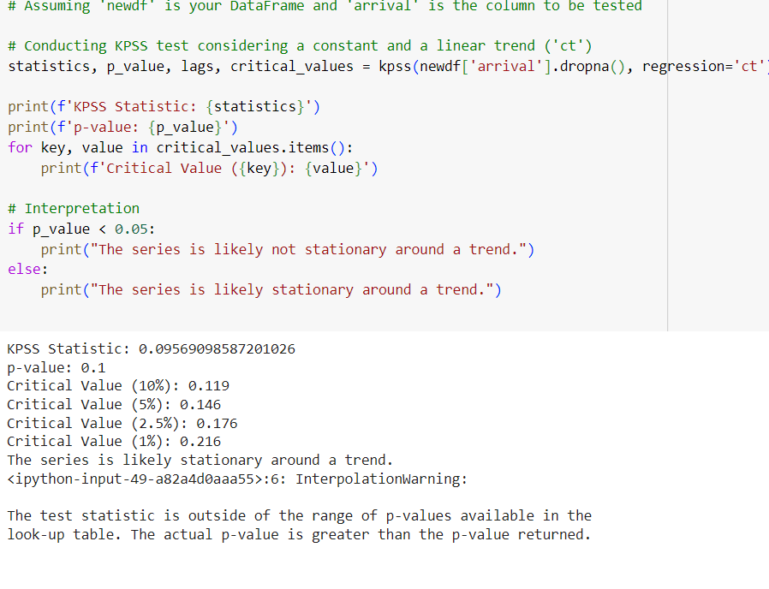
Stationarity Tests about a trend

Slide 24
KPSS Statistic: The test statistic is 0.09569, which is below the critical values for all listed significance levels (10%, 5%, 2.5%, and 1%).
p-value: The p-value is 0.1, which is greater than the common alpha level of 0.05 used to infer significance.
Given these results, we fail to reject the null hypothesis at the usual 5% significance level, indicating that the data can be considered stationary around a trend. This suggests that while there might be a deterministic trend in your series, the stochastic component (the part of the series not explained by the trend) does not exhibit unit root non-stationarity.
Stationarity Around a Trend: Series is likely stationary around a trend, implying that any trend in the data can be removed (e.g., via detrending methods) to analyze the stationary stochastic part of the series.

Slide 25
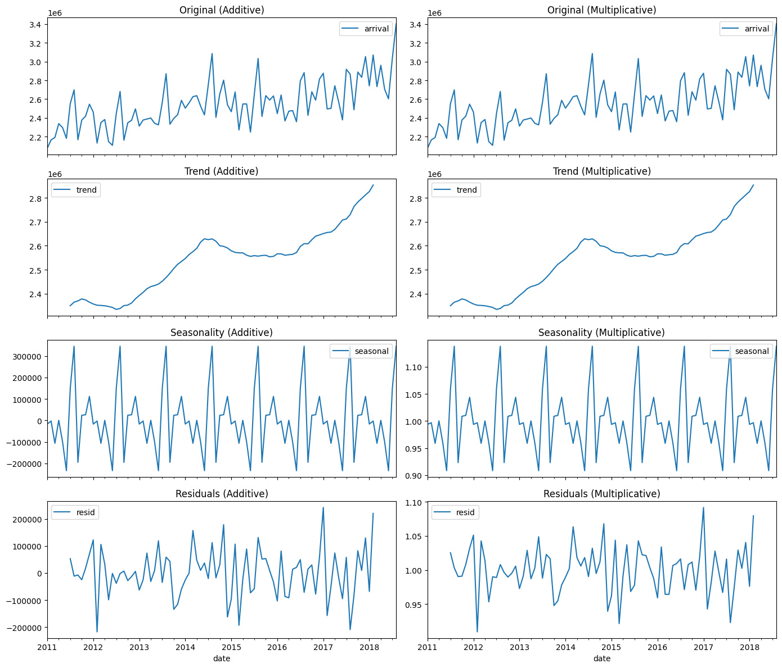
Seasonal Decomposition

Slide 26
Additive Model
Original Series: Exhibits variability and a possible trend over time.
Trend Component: There is a clear upward trend, suggesting a general increase in arrivals over time.
Seasonality Component: Seasonal fluctuations are consistent and recurring annually. The amplitude of seasonal peaks and troughs doesn't seem to increase with the level of the trend, which typically suits an additive model.
Residuals: Show some random variation, which is expected, but there seem to be a few spikes. This indicates that while the model captures the trend and seasonality, there may be outliers or irregular events not accounted for by the model.

Slide 27
Multiplicative Model
Original Series: Similar to the additive, but this model assumes the seasonal effect increases as the level of the time series increases.
Trend Component: As with the additive model, a rising trend is present, indicating an increase in arrivals over the years.
Seasonality Component: Shows proportional seasonal effects, which seem to slightly increase in amplitude as the trend increases, suggesting that the multiplicative model may capture the nature of seasonality better than the additive model.
Residuals: Appear to have some pattern, especially in later years, with some periods having consistently higher or lower residuals. This might suggest that the multiplicative model isn't fully capturing all aspects of the series, especially if these are predictable events.

Slide 28
General Inferences
Trend: Both models show an increasing trend, suggesting growth in arrivals over time.
Seasonality: The seasonal pattern is strong in both models, with high and low seasons apparent each year. The multiplicative model may capture the proportional change in seasonality better if the seasonal effects grow with the increase in arrivals.
Residuals: Neither model's residuals are completely random, indicating potential room for improvement in the modeling, such as by incorporating additional explanatory variables, adjusting for outliers, or considering a different model specification.

Slide 29
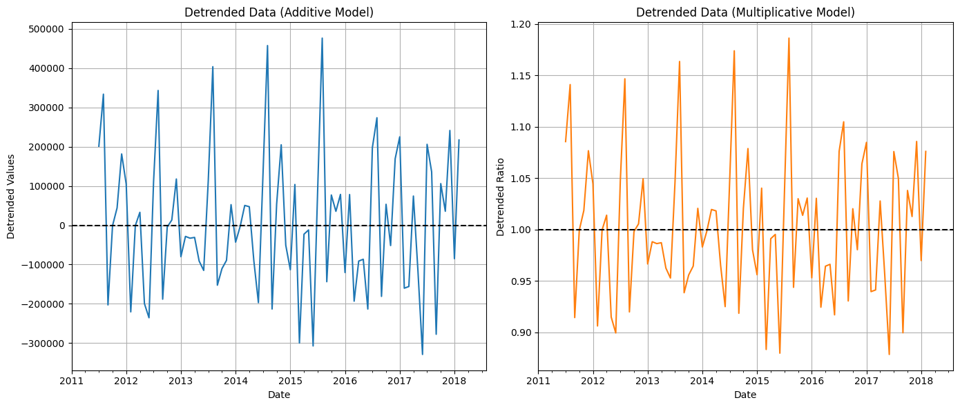
Detrended Data

Slide 30
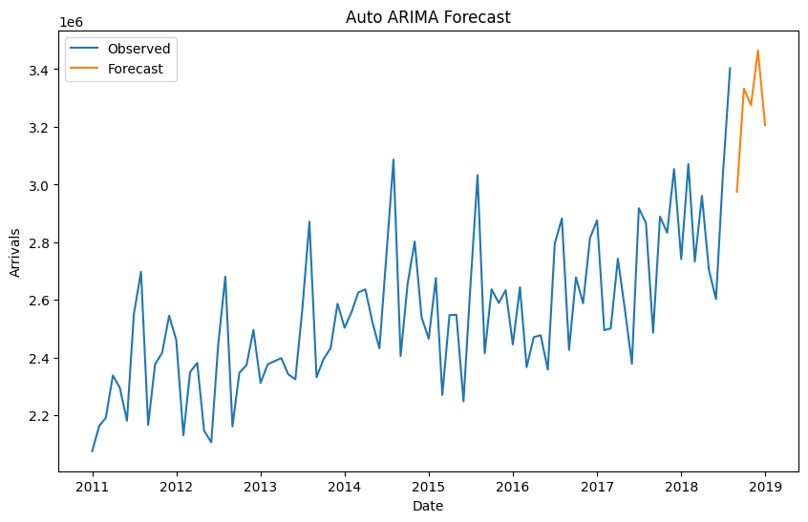
Predictions from AUTO ARIMA MODEL

Slide 31
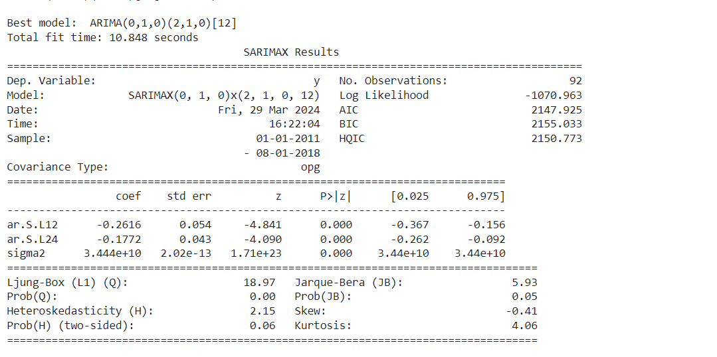

Slide 32
The SARIMAX model has the following p,q,d values:
p: This refers to the number of autoregressive terms. p=0 for the non-seasonal part, which means there are no autoregressive terms in the non-seasonal component of the model.
d: This refers to the order of differencing. the use of "SARIMAX(0, 1, 0)" implies that d=1 for the non-seasonal component, indicating the series has been differenced once to achieve stationarity.
q: This refers to the number of moving average terms. For the non-seasonal part of the model,q=0, meaning there are no moving average terms in the non-seasonal component.
For the seasonal part, the model has additional seasonal orders P,D,Q with a seasonal period of m:
P: The seasonal autoregressive order,P=2, suggests two seasonal autoregressive terms.
D: The seasonal differencing order, D=1, indicates that the series has been seasonally differenced once.
Q: The seasonal moving average order,0Q=0, which means there are no seasonal moving average terms.
The model can be summarized as SARIMAX(0, 1, 0)(2, 1, 0)[12], where the first set of parameters (0,1,0) is for the non-seasonal component and the second set (2,1,0) follows the seasonal cycle of 12 periods (which usually corresponds to 12 months in a year).

Slide 33
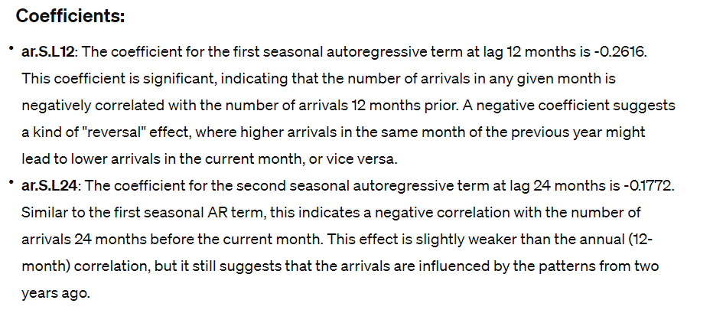

Slide 34
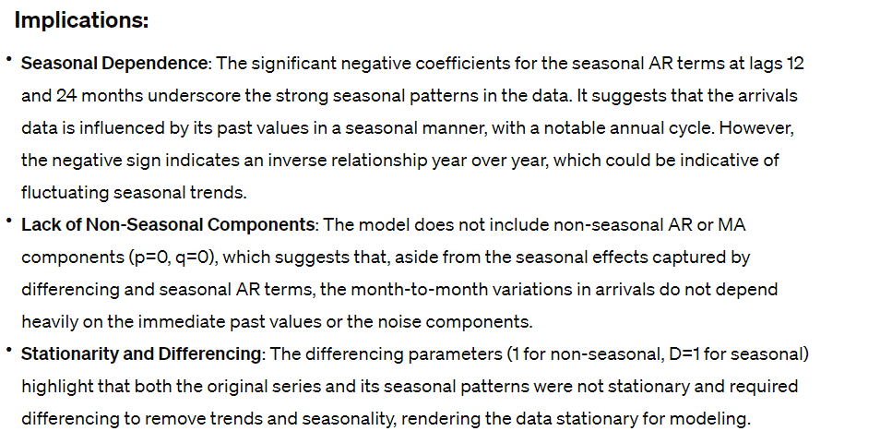

Slide 35
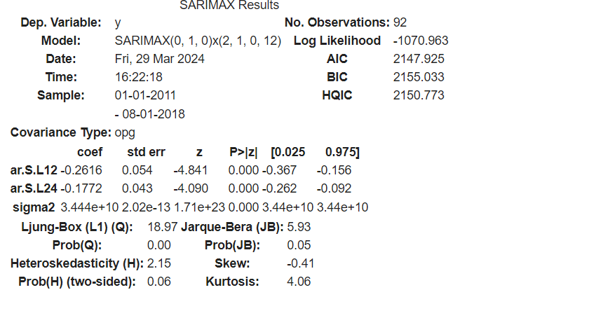
Model Summary

